Slide 1
ASP.NET
Models

Slide 2
Agenda
Introduction
Getting Started
Angular CLI
Project Overview
Debug Tools
Dependency Injection

Slide 3
Controller
Model
View

Slide 4
Model

Slide 5
Models
1
Model

Slide 6
Model
Represents data in your application
Properties
Methods
ASP.NET independent
Can be used in winforms, wpf, ...
Does not have to be a 1:1 mapping with your database

Slide 7
public class Song
{
public int ID { get; set; }
public string Title { get; set; }
public string Category { get; set; }
}

Slide 8
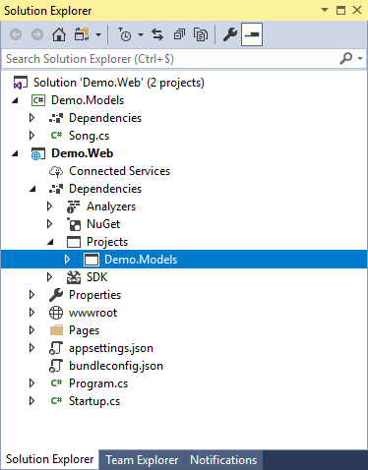

Slide 9
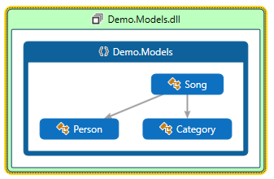

Slide 10
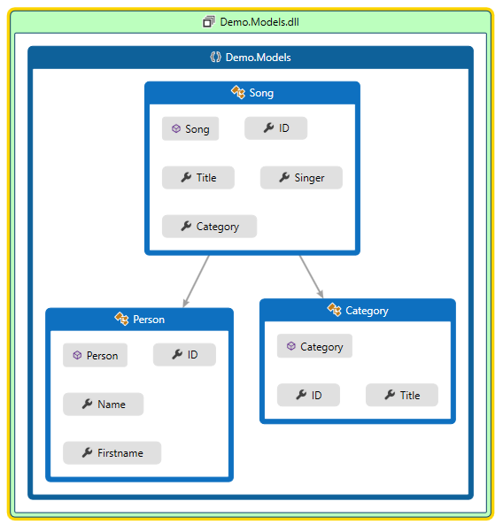

Slide 11
public class Song
{
public int ID { get; set; }
public string Title { get; set; }
public Category Category { get; set; }
public Person Singer { get; set; }
}
public class Person
{
public int ID { get; set; }
public string Firstname { get; set; }
public string Name { get; set; }
}
public class Category
{
public int ID { get; set; }
public string Title { get; set; }
}

Slide 12
public class Song
{
public int ID { get; set; }
public string Title { get; set; }
public Category Category { get; set; }
public Person Singer { get; set; }
}
public class Person
{
public int ID { get; set; }
public string Firstname { get; set; }
public string Name { get; set; }
}
public class Category
{
public int ID { get; set; }
public string Title { get; set; }
}

Slide 13
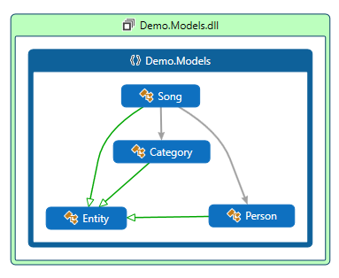

Slide 14

How can we make sure that the ID field is implemented in every model
?

Slide 15
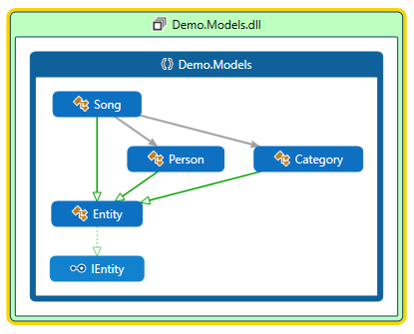

Slide 16
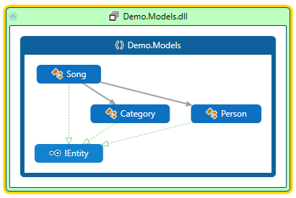

Slide 17
Models
2
Models in ASP.NET Core

Slide 18
Models in ASP.NET Core
ASP.NET core can serialize your model to
JSON
XML
other formats...
Serialize your model into the body of the HTTP response message

Slide 19
JSON and XML Serialization
In ASP.NET Web API, a media-type formatter can
Read models from an HTTP message body
Write models object into an HTTM message body
Built-in media type formatters for JSON and XML
By default inserted into the pipeline

Slide 20
Serialization
All public properties and fields are included in the serialized JSON
public class Song
{
public int ID { get; set; }
public string Title { get; set; }
public string Category { get; set; }
[JsonIgnore]
public Guid InternalCode { get; set; }
}

Slide 21
Serialization
All public properties and fields are included in the serialized JSON
public class Song
{
public int ID { get; set; }
public string Title { get; set; }
public string Category { get; set; }
[JsonIgnore]
public Guid InternalCode { get; set; }
}

Slide 22
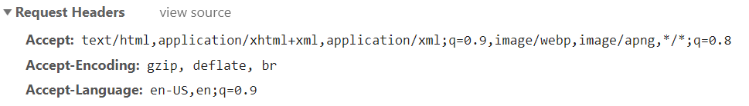
Content Negotiation
Process of selecting the best representation for your response
Accept: which media types are acceptable for the response
Accept-encoding: which encodings are acceptable
Accept-Language: preferred language
So, the client tells the server the preferred type

Slide 23
Models
2
Model Validation

Slide 24
Validation
Validate your data before you persist it in the database
Validate on different levels
On the client
On the server

Slide 25
Validation
[Required]
[StringLength(40, MinimumLength = 2)]
public string Firstname { get; set; }

Slide 26
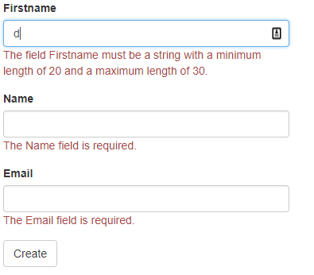
Server and client side validation
public class Person
{
[Required]
public int ID { get; set; }
[Required]
[StringLength(maximumLength: 30, MinimumLength = 20)]
public string Firstname { get; set; }
[Required]
[StringLength(maximumLength: 30, MinimumLength = 20)]
public string Name { get; set; }
[Required]
[DataType(DataType.EmailAddress)]
public string Email { get; set; }
}

Slide 27
Server side validation
[HttpPost]
public IActionResult New(Person p)
{
if (ModelState.IsValid)
{
// database actie
return RedirectToAction("Details");
}
return Json(p);
}

Slide 28
Handling Validation Errors
Web API doesn not automatically return an error to the client when validation fails

Slide 29
Handling Validation Errors
[HttpPost]
public HttpResponseMessage Post([FromBody] Song newSong)
{
if (ModelState.IsValid)
{
// do something
return new HttpResponseMessage(HttpStatusCode.OK); // StatusCode = 200
}
else
{
return Request.CreateErrorResponse(
HttpStatusCode.BadRequest,
ModelState); // StatusCode = 400
}
}

Slide 30
Models
2
Parameter Binding

Slide 31

How does ASP.NET know what to validate

Slide 32
ModelBinding
ModelBinding happens when a request is sent to a controller
HttpPost, HttpPut, ...
Controller uses the parameters to build a model which can be validated
[HttpPost]
public void Post([FromBody] Song newSong)
{
if (ModelState.IsValid) { }
}

Slide 33
Parameter Binding
By default, Web API uses the following rules to bind parameters
For simple types, get it from the URI
Bool, double, ...
For complex types, get it from the body
[FromUri] and [FromBody]

Slide 34
{
"firstname": "Kevin",
"name": "DeRudder",
"age": 42
}
[HttpPost]
public void Post(Customer customer)
{
}

Slide 35
Will not bind because json is contained in the request body
{
"firstname": "Kevin",
"name": "DeRudder",
"age": 42
}
[HttpPost]
public void Post(Customer customer)
{
}

Slide 36
{
"firstname": "Kevin",
"name": "DeRudder",
"age": 42
}
[HttpPost]
public void Post([FromBody]Customer customer)
{
}

Slide 37
Bind to specific headers
POST /api/customer
Content-Type: application/json
Access-Token: 1234AZERTY
ClientId: TheClient
{
"firstname": "Kevin",
"name": "DeRudder",
"age": 42
}
[HttpPost]
public void Post(
[FromBody]Customer customer,
[FromHeader(Name ="Access-Token")]string accessToken,
[FromHeader]string clientId)
{
}

Slide 38
Custom model bindings
public class ElmosModelBinding : IModelBinder
{
public async Task BindModelAsync(ModelBindingContext bindingContext)
{
const string propertyName = "Photo";
var valueProviderResult = bindingContext.ValueProvider.GetValue(propertyName);
var base64Value = valueProviderResult.FirstValue;
if (!string.IsNullOrEmpty(base64Value)) {
var bytes = Convert.FromBase64String(base64Value);
//...
}
}
}

